Slide 1
Flask

Slide 2
Python’s package structure
Let’s interpret “from flask import Flask”
Virtualenv is configured so that your Python interpreter understands the 3rd party library location.
source ~/virtualenv/riki/bin/activate
~/riki/lib/python2.7/site-packages is the directory where all the Python libraries installed from “python –m pip install”.

Slide 3
Python’s package structure
You find “flask” package (directory) in it.
In Python, you can use the library “from flask import Flask”
The 3rd party library directory is the starting point.
It searches the flask directory.
Flask class definition (Capital letter means it is a class definition) is in app.py.
The __init__.py contains this line “from .app import Flask, Request, Response”
.app means the “app.py” in “this directory”
This allows ”from flask” can access the “Flask”.
Confused? But it is important that you understand how Python gets the proper library.
From SE perspective, this is "conceptual integrity” and application of OOP’s encapsulation (one of the four OOP principles) as it hides classes and protects hidden classes.

Slide 4
Flask object is instantiated
app = Flask(__name__)
We call this Flask application
__name__ is automatically replaced by Python’s current python script. “hello.py” in “1a” tutorial example.

Slide 5
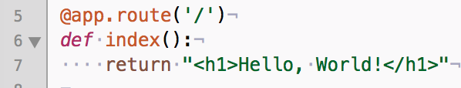
We have a mapping rule
When users request “/”, the index() is respond.
We’ll discuss request/response in the class, today we focus only on Python/Flask/Jinja2 code.

Slide 6

Equivalent C or Java’s main method
Python code is both a library and/or a standalone program.
When users invoke the Python script, this part of the code is executed.
When you execute the Python script as a module “python –m hello …” is the command.
Do you remember “python –m pip install …”?

Slide 7
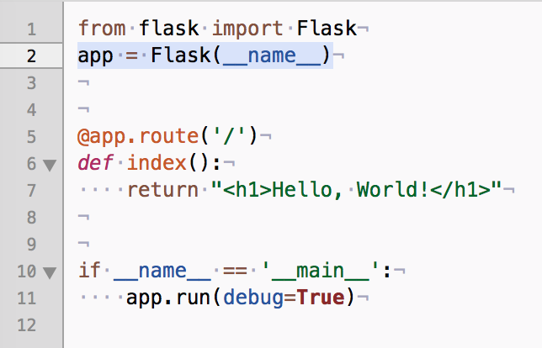
Now, let’s check if you understand every part of this code (1a) !

Slide 8
Demo 1a
Execute the Flask/Jinja2 code in your computer

Slide 9
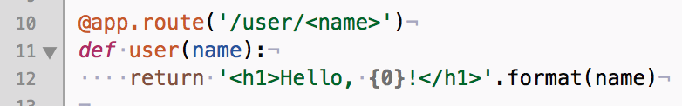
1b – hello.py
You can pass variable to the URI.
You use “<…> to pass the variable from the users.
You must not add “/” at the final
No “/user/sam/”, yes “/user/sam”
You can think of this a simple version of RESTFul API.
We’ll discuss about RESTFul API in the class.

Slide 10
Demo 1b
Execute the Flask/Jinja2 code in your computer

Slide 11
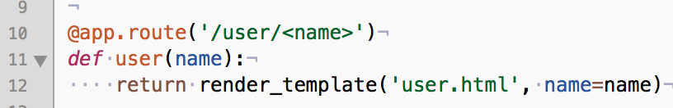
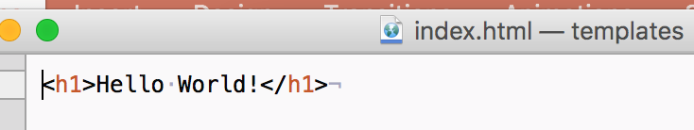
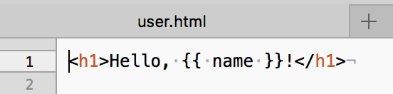
2a – Let’s use Jinja2
You can use “render_template(…)” to get HTML output.
from flask import Flask, render_template

Slide 12
Demo 2a
Execute the Flask/Jinja2 code in your computer

Slide 13
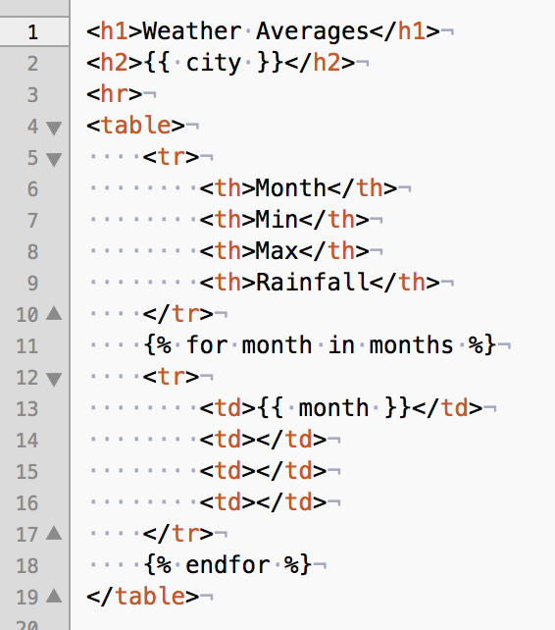
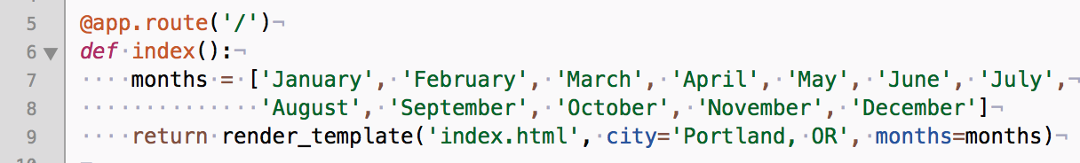
2b – weather station
You can use a list in Flask & Jinja2

Slide 14
Demo 2b
Execute the Flask/Jinja2 code in your computer

Slide 15
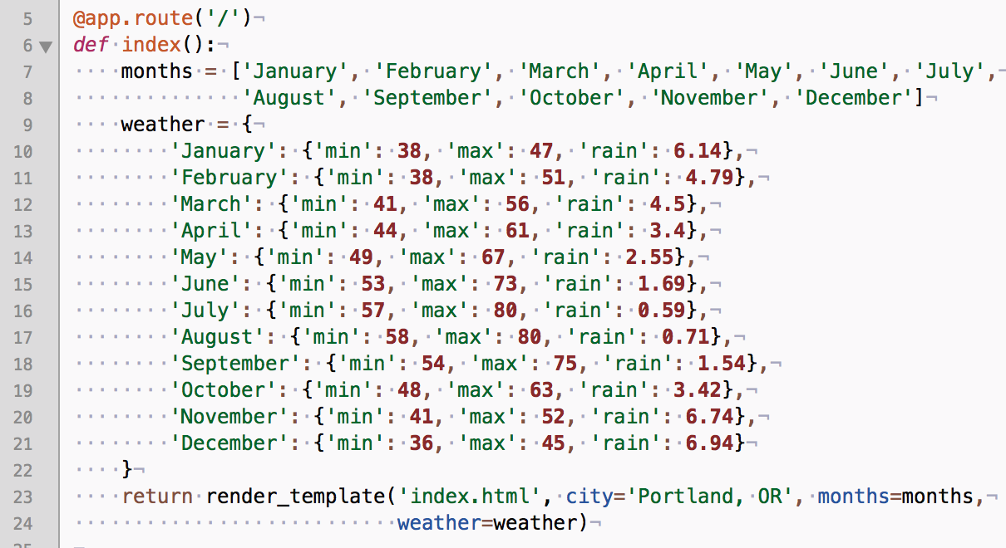
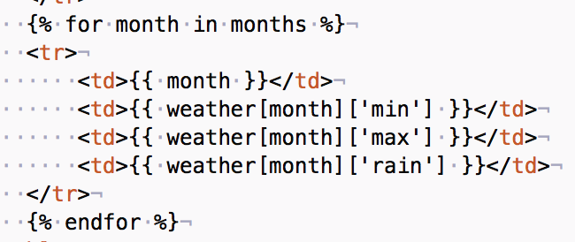
2c – weather station
You can use a library in Flask & Jinja2

Slide 16
Demo 2c
Execute the Flask/Jinja2 code in your computer

Slide 17
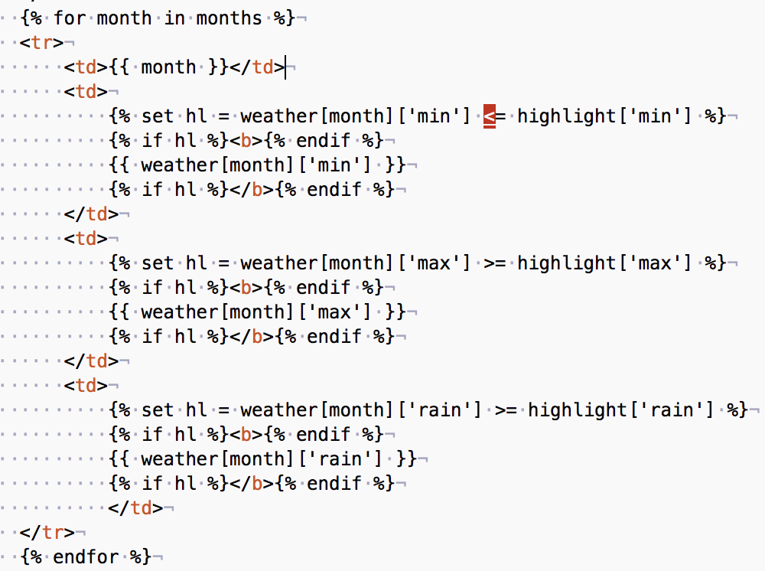
2d – Jinja2 has variables and programming code

Slide 18
Demo 2d
Execute the Flask/Jinja2 code in your computer

Slide 19
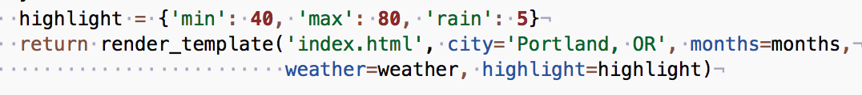
2e – you can specify highlight points
You use a dictionary for sending the information to Jinja2.

Slide 20
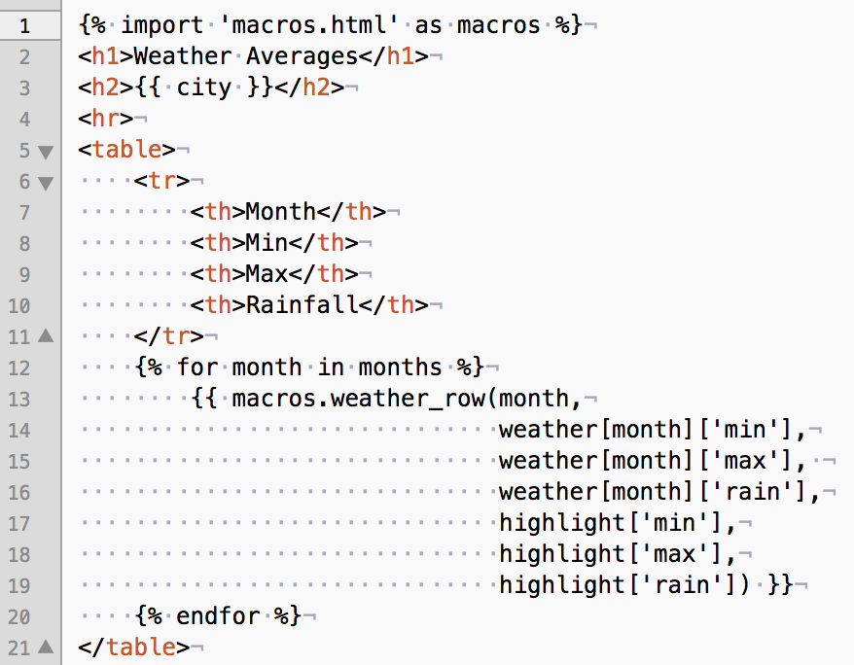
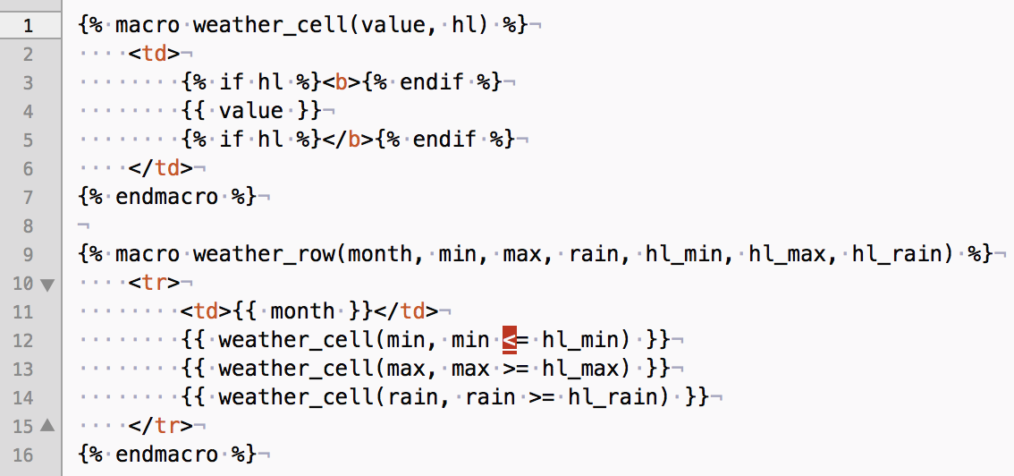
2e – Jinja2 code is too long, let’s use macro

Slide 21
Demo 2e
Execute the Flask/Jinja2 code in your computer

Slide 22
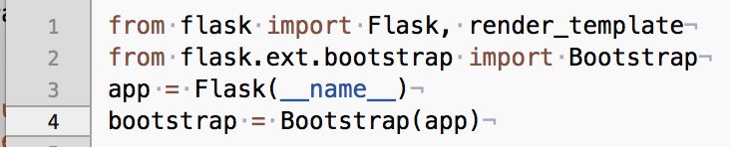
2f – Let’s use bootstrap
Bootstrap is one of the most popular HTML, CSS, and JS framework
https://v4-alpha.getbootstrap.com
Just tell Flaks you’ll use the bootstrap.
Just add one more line in Jinja2, and you’ll have better table from Bootstrap library
{% extends 'bootstrap/base.html' %}

Slide 23
Demo 2f
Execute the Flask/Jinja2 code in your computer

Slide 24
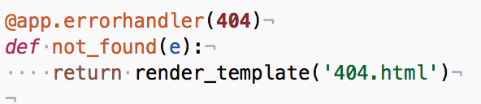
2g– error handling
You know the 404 error when there is no matching web page.
Check the 404.html.
Also, we have “base.html” that is intended to be inherited.
{% extends 'base.html' %}
{% import 'macros.html' as macros %}

Slide 25
Demo 2g
Execute the Flask/Jinja2 code in your computer.
Give a wrong input to check if you see the error page.
http://127.0.0.1:5000/fool
Click “weather” and see nothing happens.

Slide 26
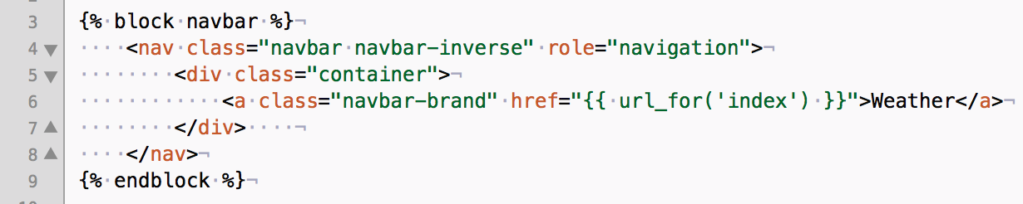
2h – “url_for(‘index’)”
You know that there is a map between a path “/” and a function “index”.
You can use the function name to get the path name using “url_for” both in Jinja2 and Flask.

Slide 27
Demo 2h
Execute the Flask/Jinja2 code in your computer.
Click “weather” and see the initial HTML page is rendered.

Slide 28
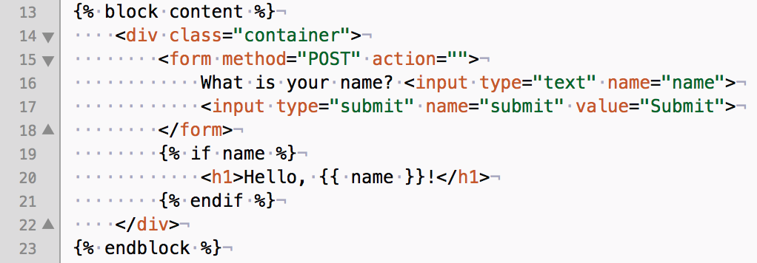
3a – From: GET/POST methods processing
We’ll talk about HTML methods in the class.
Flask can process both GET and POST methods.
HTML form always uses POST method.
Jinja2 has the form with a name ‘name’.

Slide 29
3a – Form: GET/POST methods processing
You need to understand the web processing.
Your web browser requests a HTML at ‘/’.
Flask sends the Jinja2/HTML with a form in it.
At first, you don’t use the form, so the request is ‘GET’.
So, the “if request.method == ‘POST’” becomes false.
When you click the form, now “POST” method is used in the request.

Slide 30
Demo 3a
Execute the Flask/Jinja2 code in your computer.
See the initial HTML and then click the form to see the change in the HTML.
Think about the process in the Flask and Jinja2.

Slide 31
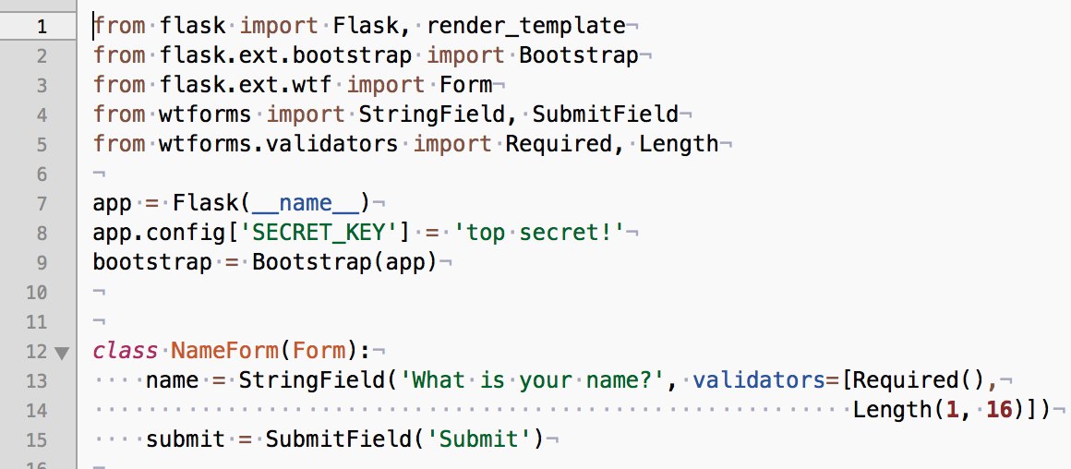
3b – Flask forms (WTF forms)
You can use Flask forms
You need to add ‘SECRET_KEY’ for security issue in Flask forms.
WTF form is utility for better handling.
WT From is another wrapper that Flask uses
Also check the validator service.

Slide 32
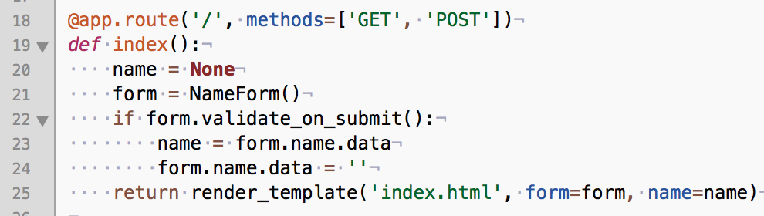
3b – Flask forms
You just instantiate the form and use the object.
This is the essence of OOP idea!

Slide 33
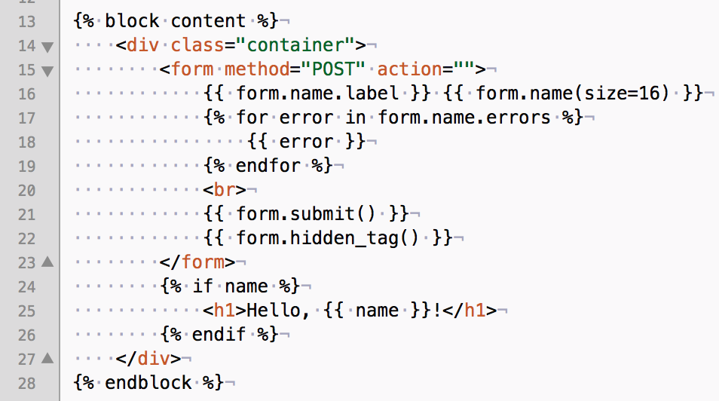
3b – Flask forms
Jinja2 also understand the Flask forms.

Slide 34
Demo 3b
Execute the Flask/Jinja2 code in your computer.
Give very long name to see if Flask shows an error.

